Slide 1
Final Project Presentation:
Mano CPU Architecture With Customable Instruction Set
Yuval Tzur

Slide 2
The Project’s Purpose:
Students can’t experiment with assembly instruction creation.
Students can’t experiment with assembly instruction editing.
Current tools are bound to a single instruction set.
Current tools are bound to a single instruction format.

Slide 3
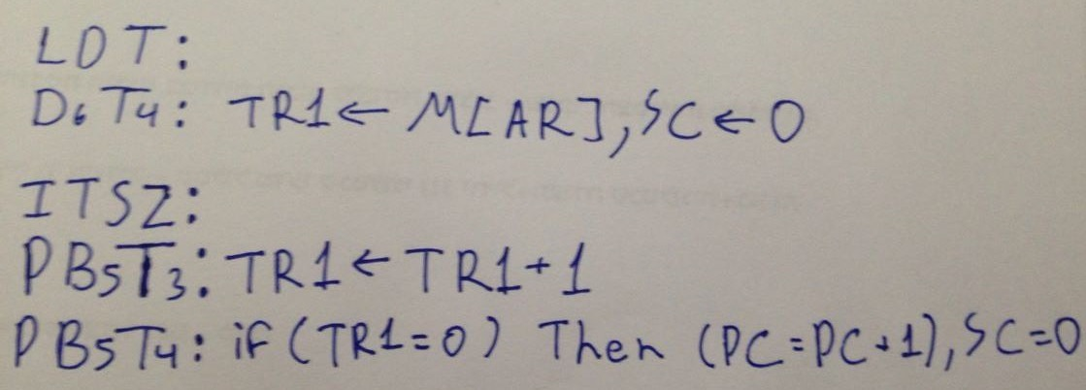
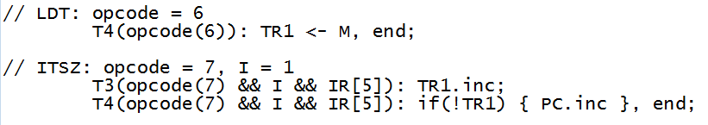
The Goal:
Task:
  Replace the ISZ instruction with an instruction that loads a number into TR1:
  LDT Address // TR1 ← M
  Add a register reference instruction ITSZ:
  Increment TR1 and skip next instruction if zero.
  Goal:
  Change this:
  To this:

Slide 4
It’s alive…
It’s ALIVE!
ALIVE!!!
A live demo…

Slide 5
Specs for Geeks:
The system is implemented using Java.
The compiler and assembler are implemented using Java CUP.
All system HW components are implemented as Java classes.
The system emulates the components at a (logical) bitwise level.
A routing table defines the connectivity between components, and the order in which data travels when moved from one component to another.
Compiling an instruction set generates both a CPU that implements it and a compatible assembler.
Instruction sets can be created or reloaded dynamically during runtime.

Slide 6
A bumpy road…
Using a high level language to emulate low level functionality isn’t as simple as it may seem.
Dynamically changing the functionality of a program during runtime isn’t intuitive.
Creating a program that auto-generates parts of itself (Auto-generated code) requires careful planning.

Slide 7
What does the future hold?
Implementation of I/O components in the GUI.
GUI improvement.
Integration of the new system as a tool to be used in the “Computer Architecture” course.
Scale the system to allow customable architecture, as well as the instruction set.

Slide 8
Questions?

